Slide 1
CROSSWORD PUZZLE GAME
GROUP MEMBERS:
M. ANAS HASSAN • 20K-1726
M. WARZAN • 20K-1649

Slide 2
INTRODUCTION
The Crossword puzzle is a game in which we have to find and mark all the hidden words inside the grid. The words may be placed horizontally, vertically, or diagonally.

Slide 3
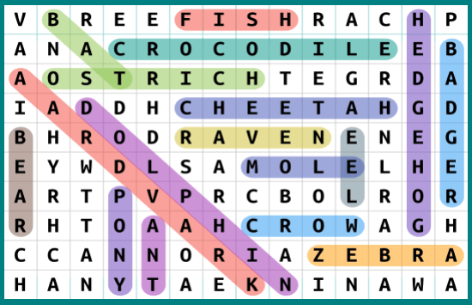
HOW TO PLAY
Search that word in all direction up, down ,left, right and diagonally.
If find marked that words simply

Slide 4
BENEFITS OF THIS GAME
MIND SHARP
This game helps us to improves mind ability as well as improves our focus to solve problems.
IMPROVE STRATEGY
To solve problem different strategies implemented in this way its help to improve strategy.

Slide 5
FEATURES
SOME FEATURES ARE
It contains 5 different choices for the user. It is user friendly.
User have right to change font and background colour.
User can see their score and lives.
It contains 3 levels with different difficulty level.
If user enter correct word, score increemented while lives decreemented if wrong word enter.

Slide 6
SOME SNAPSHOTS

Slide 7
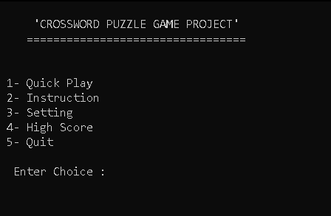
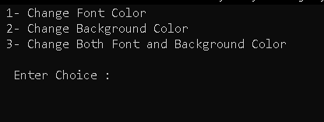
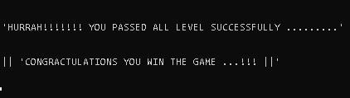
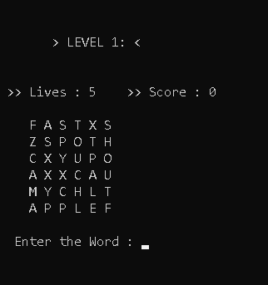
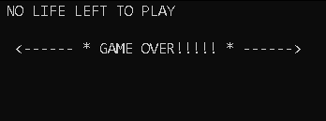
START UI
LEVEL 1
SETTINGS
GAMEOVER
WINNER

Slide 8
THANKS FOR YOUR TIME

